Slide 1
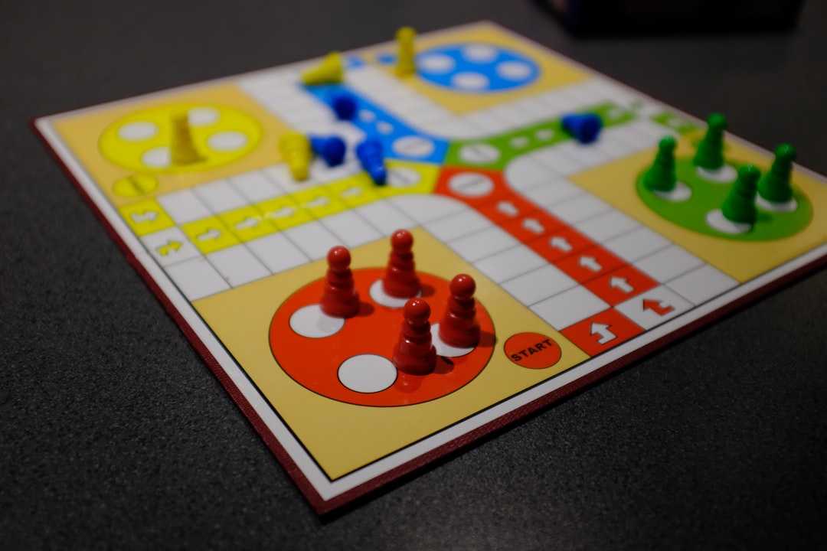
Implementation of a Board Game - LUDO
Project Domain - Matrices
Group 12 Details
Rashika Jain AU2020178
Kanvi Patel AU2040235
Jatin Parmar AU2040118
Kishan Akbari AU2040155

Slide 2
Background
Ludo originated in India. It is derived from the Indian game Pachisi.
The game and its variations are popular in many countries and under various names.
It is a 4-6 player game with each player given a specific color. Each player is given 4 tokens of a specific color and their task is to make the tokens reach their respective homes fastest, by the numbers appearing on the dice they rolled.
It is the only game that has converted according to the players’ mindset concerning time and country. Many countries have two sets of dice and board.

Slide 3
Motivation
These days the world is moving towards Information Technology, there was a requirement for an enhancement for our manual ludo game.
As we are in the jet age, modern approaches are introduced everywhere including, games.
We have used string arrays to implement the whole game. We have also used Dijkstra Algorithm.
The main motive behind the computer-based ludo game is that it will help us sharpen intelligence. It will also help in improving analytical thinking ability.

Slide 4
Problem Statement
In current world due to the globe advancing towards information technology, our local (manual) ludo game needed to be improved.
The following are some of the issues that have been noted in the local ludo game:
A local ludo/traditional ludo game cannot be played by one and only one person, two to four people are minimum required.
Counting the pieces might be inaccurate at times. For instance, instead of counting seven moves, count eight in Local Ludo game.
Either player has the option of cheating on the opponent by taking a piece Home without travelling the regular route.

Slide 5
Literature Survey
We concluded that for most of the path, we are moving forward. The rolling of the dice determines how many steps we move. Towards the end, the piece can “bounce back” if we exceed the exact value required to reach home.
By doing some research on the topic we found out that Ludo is a board game that can be modeled as a first-order Markov chain as it is memory less. And the Markov process can be implemented by using a transition matrix.

Slide 6
At every step of the algorithm, we find a vertex that has a minimum distance from the source. When further researching we found that we can attain this using Dijkstra’s algorithm.
The main objectives of the proposed design includes:
To help in reasoning faster and better.
To bring fun into people’s homes and offices.
To act as a good form of relaxation.
To be able to create a real-life feature.
Relate computer games in various spheres of life e.g. business, art, engineering, science etc.

Slide 7
Reproduced Work
The work can be basically categorized in three subparts:-
Mathematical Application based on geometry, Basic Maths.
Object oriented programming.
Dijkstra algorithm, disjoint union set, Graph.

Slide 8
First of all, we made a string array for our ludo board. Then, we chose some coordinates for the reserved space like a star in an actual ludo game. And then, we made a duplicate array to fix coordinates because sometimes more than two pawns can be in the same place. After that, we allotted our pawn fixed coordinates(starting and ending coordinates). The next step was to make the path for these pawns. We made individual classes perform different actions. For instance, the board class includes a printing board that has the current status of the pawn during every turn. Check coordinates, get the next position. Piece class contains the color and the location of all the pawns at every second. The user class includes logic and details of the color and location of the home. In the person class, we have included the logic of the movement of the pawns and the changing of their coordinates according to the rolling of the dice.

Slide 9
In our code, we have used graphs, disjoint union set and Dijkstra algorithm. A graph is the data structure that we used to connect coordinates in our matrix. The pawn traverses the matrix through the graph. Then, we used the Dijkstra Algorithm. The Dijkstra algorithm is used to find the shortest path. In our project, we have used the Dijkstra algorithm for the pawn to reach home.

Slide 10
Plan of Action
We came across the unique idea of making a board game after researching amongst Mathematical Applications of Algebra. Then we finalized our topic belonging to matrices. So we chose to work on the game ludo based on matrices. After deciding the topic, we came to the part of programming during which we have faced some difficulties.
Next we will work on board regarding user and a file named run and then error detection in our code and checking of all edge cases, at the end we will beautify our code and revised all classes.

Slide 11
Contributions
Research and Mathematical Formulation : Kishan, Jatin
Coding : Rashika, Kanvi, Jatin, Kishan
Documentation : Kanvi
Presentation : Rashika

Slide 12
Thank You

